Slide 1

DIABETES PREDICTION
AI-Healthcare MSDSM-01
Group- III
Avijit Biswas
R Himaswetha
Ritik Yadav
Siddhesh Kulkarni

Slide 2
Objective
The objective of this project is to develop a machine learning model that can accurately predict diabetes risk based on clinical and lifestyle factors. By evaluating multiple models, fine-tuning hyperparameters, and using neural networks, the project aims to create a model that balances accuracy, interpretability, and efficiency for potential use in early diabetes risk screening.
Aim
The aim of this project is to design and optimize a reliable prediction model for diabetes using various machine learning techniques, including logistic regression, random forests, support vector machines, and neural networks. Through systematic training, validation, and hyperparameter tuning, the project seeks to achieve high predictive accuracy and model robustness, providing insights that could support healthcare practitioners in identifying high-risk individuals.

Slide 3
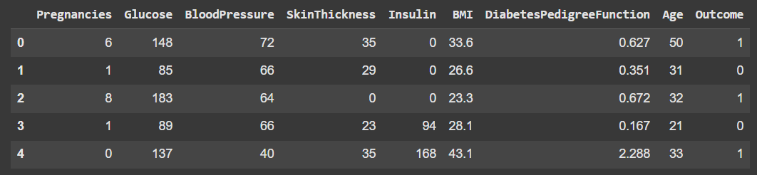
We have used machine learning techniques for diabetes prediction based on a dataset of 770 records. Multiple models, including Logistic Regression, Random Forest, Support Vector Machine (SVM), and a hyperparameter-tuned Artificial Neural Network (ANN), were evaluated.
Key processes include data pre-processing, model training, performance evaluation, risk factor analysis, and hyperparameter optimization. The ANN model achieved a high accuracy of 84.98%, highlighting its potential for reliable diabetes prediction from clinical data.

Slide 4
Key Features Used in the Project
Pregnancies: Number of pregnancies for each individual. Pregnancy can have a significant impact on the risk of developing diabetes, particularly gestational diabetes, which increases the likelihood of type 2 diabetes later in life.
Glucose: Plasma glucose concentration. High blood glucose levels are a primary indicator of diabetes. Monitoring glucose levels is essential for diagnosing and managing diabetes.
Blood Pressure: Diastolic blood pressure (mm Hg). Hypertension (high blood pressure) is commonly associated with diabetes, and it is crucial to include this feature to understand its influence on diabetes risk.
Skin Thickness: Triceps skin fold thickness (mm). Skin fold thickness is used as a measure of body fat. Higher body fat percentages can be an indicator of obesity, a significant risk factor for diabetes.
Insulin: 2-hour serum insulin (mu U/ml). Insulin levels provide insights into how the body processes glucose. Abnormal insulin levels can indicate insulin resistance or pancreatic issues, both of which are key factors in diabetes.
BMI (Body Mass Index): Weight in kg / (height in m). BMI is a widely used measure of body fat based on height and weight. A high BMI is strongly associated with an increased risk of diabetes.
Diabetes Pedigree Function: Likelihood of diabetes based on family history. Family history is a significant predictor of diabetes risk. This feature helps quantify genetic predisposition to diabetes.
Age: Age of the individual. Age is an important factor as the risk of developing diabetes increases with age.
Outcome: indicates diabetes, 0 indicates no diabetes. This is the target variable that the models aim to predict, based on the combination of the features listed above.

Slide 5

Data Preprocessing
Handling Missing Values:
Used Simple Imputer to replace missing values with the mean of each feature, ensuring a complete dataset.
Feature Scaling:
Applied Standard Scaler to bring all features to a common scale (mean = 0, standard deviation = 1).
This step improves model convergence, especially for distance-based models.
Data Split:
80% Training and 20% Testing: Ensured the model has ample data for learning while preserving a test set for unbiased evaluation.

Slide 6
Model Building
Logistic Regression:
Used as the initial model to establish a baseline for diabetes prediction accuracy.
The model's coefficients were analyzed to understand the impact of individual features on diabetes outcomes.
Random Forest:
Implemented to improve predictive accuracy by leveraging the power of ensemble learning.
The feature importance scores provided insights into which features played a significant role in diabetes prediction.
Support Vector Machine (SVM):
Applied to explore complex decision boundaries and assess whether non-linear relationships improved prediction accuracy.
The kernel functions allowed for the handling of non-linearly separable data.
Hyperparameter Tuning:
Grid Search and Random Search:
Employed to optimize model hyperparameters for Logistic Regression, Random Forest, and SVM.
The search processes aimed to identify the best combination of hyperparameters that maximized validation accuracy.
Cross-Validation:
Used during hyperparameter tuning to ensure that the models' performance was evaluated robustly and not overly optimistic.
Enabled us to select the models with the best generalization capability to new data.

Slide 7

Model Evaluation
Metrics Used:
Accuracy: Proportion of correct predictions, providing a general measure of model performance.
Precision: Indicates the model's accuracy for positive predictions, crucial for understanding the correctness of predicted positive cases.
Recall: Reflects the model's sensitivity for detecting diabetes cases, important for assessing how well the model identifies true positive cases.
F1-Score: Balances precision and recall, providing a single measure that accounts for both false positives and false negatives.
ROC-AUC: Measures the model's ability to discriminate between classes across various thresholds, offering a comprehensive view of model performance

Slide 8
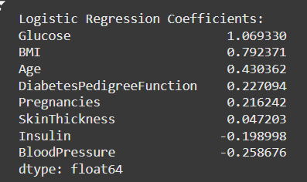
Logistic Regression
Interpretation of Logistic Regression Coefficients
Key Points:
Glucose: 1.069330-Highest positive coefficient, indicating that high glucose levels significantly increase the likelihood of diabetes.
BMI: 0.792371-Significant positive impact, suggesting higher BMI is strongly associated with diabetes risk.
Age: 0.430362-Notable positive impact, implying older age increases the risk of diabetes.
Diabetes Pedigree Function: 0.227094-Moderate positive impact, indicating a genetic predisposition to diabetes.
Pregnancies: 0.216242-Slight positive impact, suggesting more pregnancies might increase diabetes risk.
Skin Thickness: 0.047203-Minimal positive impact on diabetes risk.
Insulin: -0.198998-Slight negative impact, implying lower insulin levels might decrease the risk of diabetes.
Blood Pressure: -0.258676-Negative impact, indicating lower blood pressure might decrease the risk of diabetes.
Summary:
Glucose and BMI are the most critical factors in predicting diabetes.
Age and Diabetes Pedigree Function also play significant roles.
Pregnancies, Skin Thickness, Insulin, and Blood Pressure have varying degrees of influence.

Slide 9
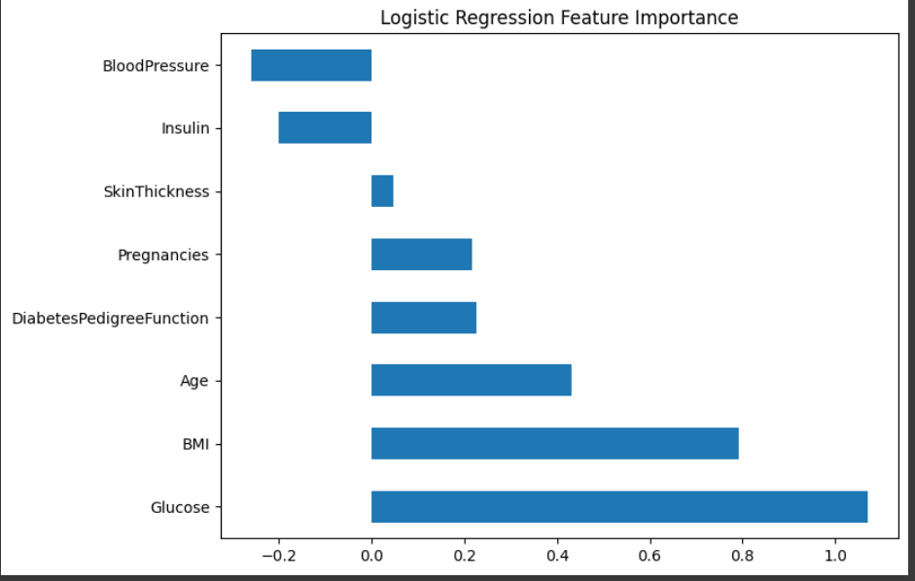
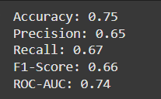
Logistic Regression
Key Features and Impact:
Glucose: Strong positive correlation with diabetes.
BMI: Also positively correlated, showing that higher BMI increases diabetes risk.
Age: Indicates that older age correlates to higher diabetes risk.
Genetic Influence: Diabetes Pedigree Function shows a moderate effect.
Other Features: Pregnancy count has a slight positive effect, while insulin and blood pressure have a small negative impact.
Conclusion: Logistic Regression provides transparent insights, reinforcing glucose and BMI as primary predictors.
Performance Metrics for Logistic Regression
Key Metrics:
Accuracy: Around 73-75% across runs.
Precision, Recall, F1-Score: Balanced performance in identifying both diabetic and non-diabetic cases.
ROC-AUC: Scores around 0.70-0.74, indicating moderate predictive ability.
Conclusion: The model is balanced but could be improved with fine-tuning for higher accuracy.

Slide 10
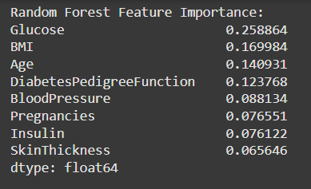
Random Forest
Interpretation of Random Forest Feature Importance
Key Points:
Glucose: 0.258864
The most significant feature, indicating higher glucose levels strongly increase the likelihood of diabetes.
BMI: 0.169984
High BMI is strongly associated with an increased risk of diabetes.
Age: 0.140931
Older age is a critical predictor, with increased age correlating to higher diabetes risk.
Diabetes Pedigree Function: 0.123768
Reflects genetic predisposition; higher scores indicate a higher risk.
Blood Pressure: 0.088134
Contributes to diabetes prediction but to a lesser extent than the top features.
Pregnancies: 0.076551
More pregnancies might slightly increase the risk of diabetes.
Insulin: 0.076122
Insulin levels also contribute but have less impact than glucose and BMI.
Skin Thickness: 0.065646
Minimal impact on diabetes risk compared to other features

Slide 11
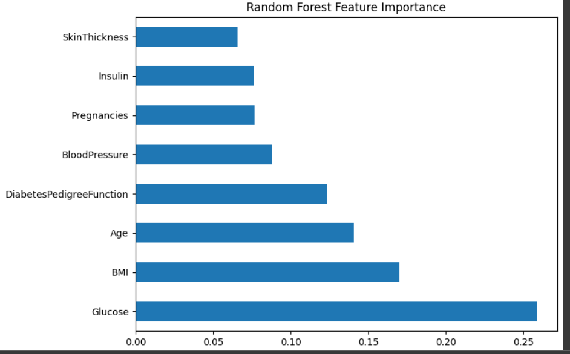
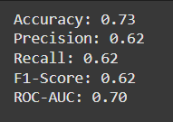
Random Forest
Interpretation of Random Forest Model Metrics
Accuracy (0.73): The model correctly predicts 73% of cases, showing reasonable reliability but leaving room for improvement.
Precision (0.62): When the model predicts diabetes, it’s correct 62% of the time, which helps reduce false positives.
Recall (0.62): The model captures 62% of actual diabetic cases, a decent level for identifying true positives but could be higher.
F1-Score (0.62): Balanced precision and recall, showing the model is fairly consistent in both.
ROC-AUC (0.70): Indicates good discrimination between diabetic and non-diabetic cases, though further tuning could enhance it.
Conclusion
The model’s balanced metrics suggest it’s a solid starting point for diabetes prediction. Improvements in recall or ROC-AUC could enhance its reliability, particularly for clinical use.

Slide 12
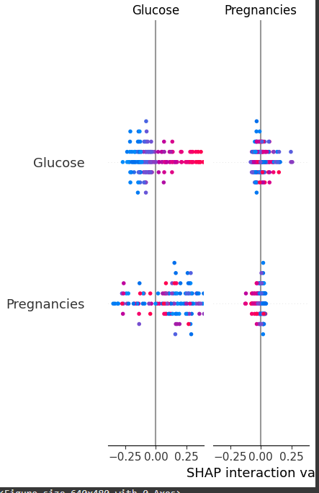
SHAP - SHapley Additive exPlanations
SHAP is a method based on Shapley values from cooperative game theory, used to interpret complex models by explaining how much each feature contributes to the prediction. It provides a way to visualize and understand feature interactions, such as how two features together influence the model's prediction in an Interaction Plot.
The SHAP interaction plot provides insights into how Glucose and Pregnancies interact to influence diabetes predictions.
Interpretation: The plot shows that as glucose levels increase, the probability of diabetes also increases. When glucose is high, having more pregnancies further raises the risk. This interaction effect emphasizes that high glucose levels combined with a history of multiple pregnancies significantly contribute to the likelihood of diabetes, giving clinicians insight into which patients may need closer monitoring

Slide 13
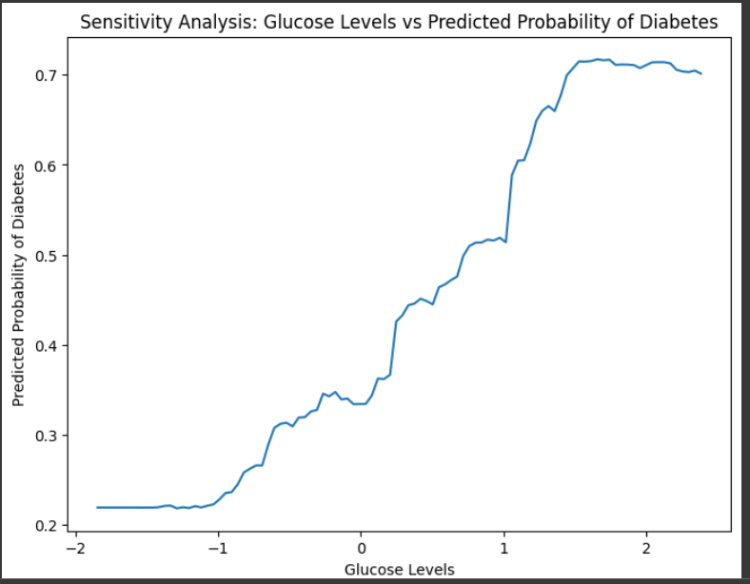
Sensitivity Analysis
Interpretation of Sensitivity Analysis
Key Points:
Glucose Levels: The x-axis ranges from -2 to 2, representing low to high glucose levels.
Predicted Probability of Diabetes: The y-axis ranges from 0.2 to 0.7.
Graph Line: Starts at a predicted probability of around 0.2 for low glucose levels and increases to around 0.7 for higher glucose levels.
Summary:
The sensitivity analysis shows a strong positive correlation between glucose levels and the predicted probability of diabetes.
As glucose levels increase, the likelihood of being predicted as diabetic also increases significantly.

Slide 14
Hyperparameter Tuning with ANN
Hyperparameter Tuning Overview:
Purpose of Tuning: Adjusting hyperparameters like learning rate, batch size, and number of layers is essential to maximize the ANN's predictive performance.
Keras Tuner: An efficient tool that automates the search for the best hyperparameters, saving time and improving results.
ANN Architecture: The model is a simple feedforward neural network with Dense layers, ReLU activation for hidden layers, and sigmoid activation for the output layer.
Optimized Parameters: Keras Tuner helped optimize critical parameters, such as the number of layers and neurons per layer, leading to better model accuracy.
Result: The ANN’s performance improved with optimized settings, showing higher accuracy and generalization capability.

Slide 15
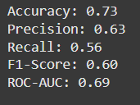
Interpretation of Support Vector Machine
Key Metrics:
Accuracy: 0.73
The model correctly predicted 73% of the outcomes.
Precision: 0.63
Of the instances the model predicted as diabetic, 63% were correct.
Recall: 0.56
The model identified 56% of the actual diabetic instances.
F1-Score: 0.60
Combines precision and recall into a single metric.
ROC-AUC: 0.69
Reflects the model's ability to distinguish between diabetic and non-diabetic instances

Slide 16
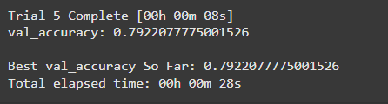
Keras Tuner Results Interpretation
Objective: The goal of tuning here is to maximize val_accuracy (validation accuracy) by testing different configurations of the neural network model.
Trial Performance:
Trial 5 Complete:
Validation Accuracy: Achieved a validation accuracy of 0.7922 (79.22%) in
this trial.
Best Validation Accuracy So Far: The highest validation accuracy recorded across all trials is 0.7922 (79.22%).
Conclusion:
The model’s validation accuracy reached a peak of 79.22% after trying out various configurations, giving an optimized setup within the maximum trial limit (5 trials).
This result suggests that the neural network has been tuned effectively for validation accuracy, balancing the model's complexity and performance.
Using Keras Tuner, this tuning process helps ensure that the neural network model is configured with a combination of layers that best supports prediction accuracy without overfitting, as reflected in the improved validation accuracy.

Slide 17
Recommendations for the Patients
Focus on Key Health Indicators:
Glucose Levels:
Our model identified blood glucose levels as the most significant predictor of diabetes. Patients should prioritize regular blood glucose monitoring, especially if they have risk factors for diabetes, to detect early changes and manage levels within a healthy range.
Body Mass Index (BMI):
Maintaining a healthy BMI was another key indicator in predicting diabetes. Patients should consider incorporating balanced nutrition and regular physical activity to achieve or maintain a healthy weight, as excess weight, particularly abdominal fat, can increase diabetes risk.
Regular Health Screenings:
Early screening and regular health check-ups are essential for detecting diabetes early. Patients, especially those with a family history of diabetes, high BMI, or other risk factors, should consult with their healthcare provider for routine tests, including glucose tolerance tests and hemoglobin A1c checks.
Adopt a Balanced Diet:
Diet plays a crucial role in managing blood sugar levels. Patients are encouraged to focus on a balanced diet rich in fiber, lean proteins, whole grains, and vegetables. Limiting intake of refined sugars, processed foods, and trans fats can help manage glucose levels and reduce diabetes risk.

Slide 18
Recommendations for the Patients
Exercise Regularly:
Engaging in regular physical activity can improve insulin sensitivity and aid in maintaining a healthy weight. Activities like brisk walking, cycling, and strength training are beneficial and can be adapted to individual fitness levels and lifestyle.
Stress Management:
Chronic stress has been linked to elevated blood glucose levels. Incorporating stress-reducing practices like meditation, yoga, and adequate sleep can support better metabolic health and improve overall well-being.
Medication Adherence and Lifestyle Changes:
For those already diagnosed with prediabetes or diabetes, adhering to prescribed medications and making lifestyle adjustments can effectively manage and sometimes even reverse prediabetic conditions. Working closely with healthcare professionals to monitor progress and adjust treatment plans is also key.
Conclusion
This project underscores that maintaining healthy lifestyle practices—such as managing glucose levels, sustaining a healthy BMI, and adopting a balanced diet—are fundamental in reducing the risk of diabetes. By taking proactive steps, such as regular screenings and engaging in positive health habits, patients can gain more control over their health outcomes. This predictive model serves as a supplementary tool for patients and healthcare providers, offering insights into risk factors and supporting early intervention strategies.

Slide 19
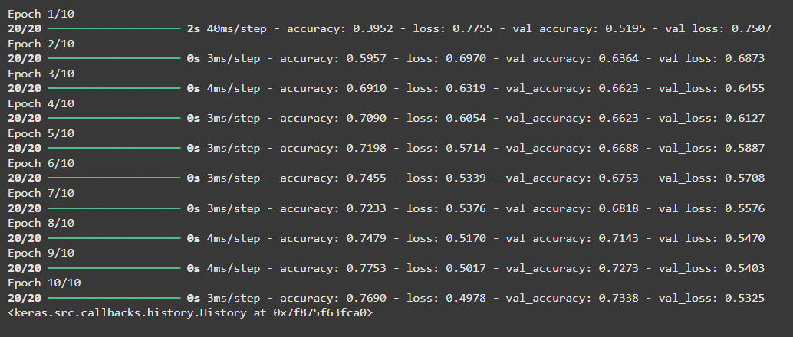
Training and Validation
Key Metrics Over 10 Epochs:
Accuracy:
Initial: 39.52% (Epoch 1)
Final: 76.90% (Epoch 10)
Validation Accuracy:
Initial: 51.95% (Epoch 1)
Final: 73.38% (Epoch 10)
Loss:
Initial: 0.7755 (Epoch 1)
Final: 0.4978 (Epoch 10)
Validation Loss:
Initial: 0.7507 (Epoch 1)
Final: 0.5325 (Epoch 10)
Summary:
Both accuracy and validation accuracy improved significantly over the 10 epochs.
Loss and validation loss decreased steadily, indicating that the model's performance and generalization capability have improved.

Slide 20
THANK YOU

